Slide 1

NonLinear Control
Prof. Miguel Ayala Botto
SIMULATION PROJECT
STUDENTS
Pedro Magalhães
108470
Francisco Carvalho
111000
DATE:
14/01/2025

Slide 2
SUMMARY
01
NonLinear Actuartors
02
Popov Criteria
03
Input-State Feedback Linearization
04
Input-Output Feedback Linearization
05
Sliding Mode Control

Slide 3
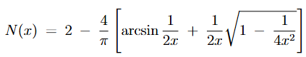
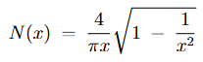
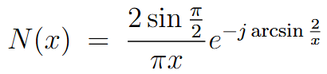
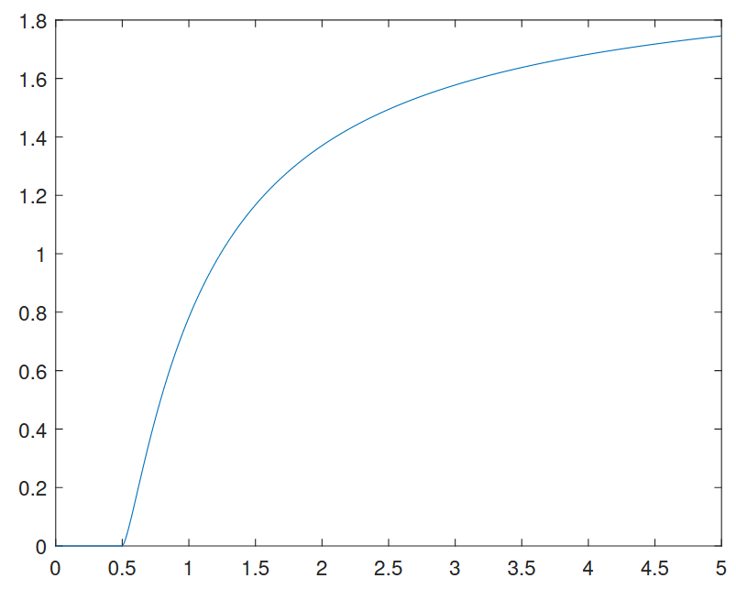
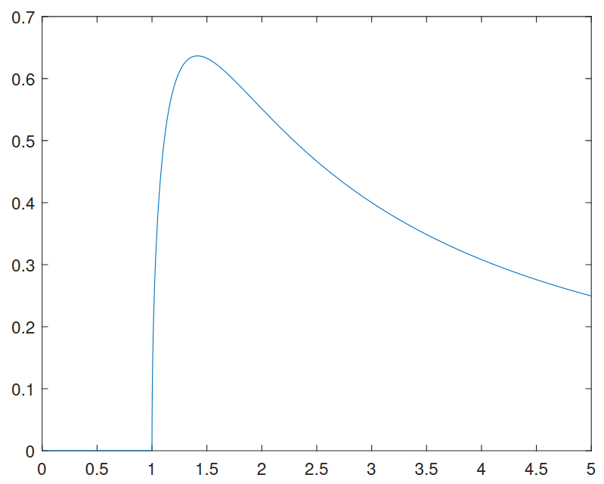
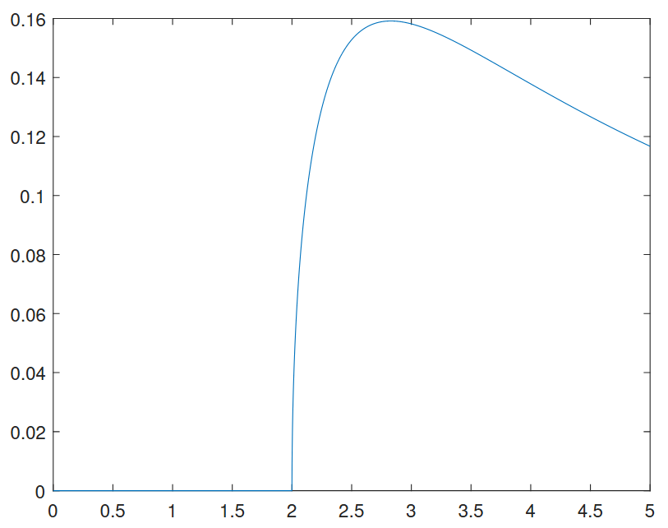
NonLInear actuators
Popov Criteria
ISFL
IOFL
Sliding Mode
NonLinear Actuators
Describing Functions
Actuator 1
Actuator 2
Actuator 3

Slide 4
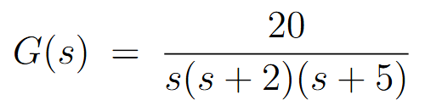
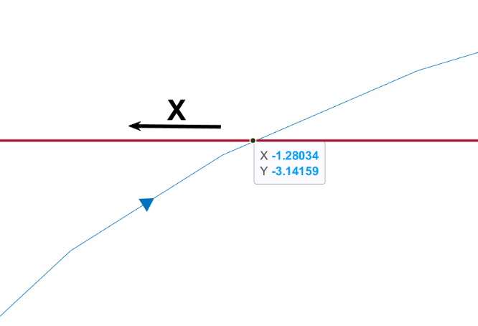
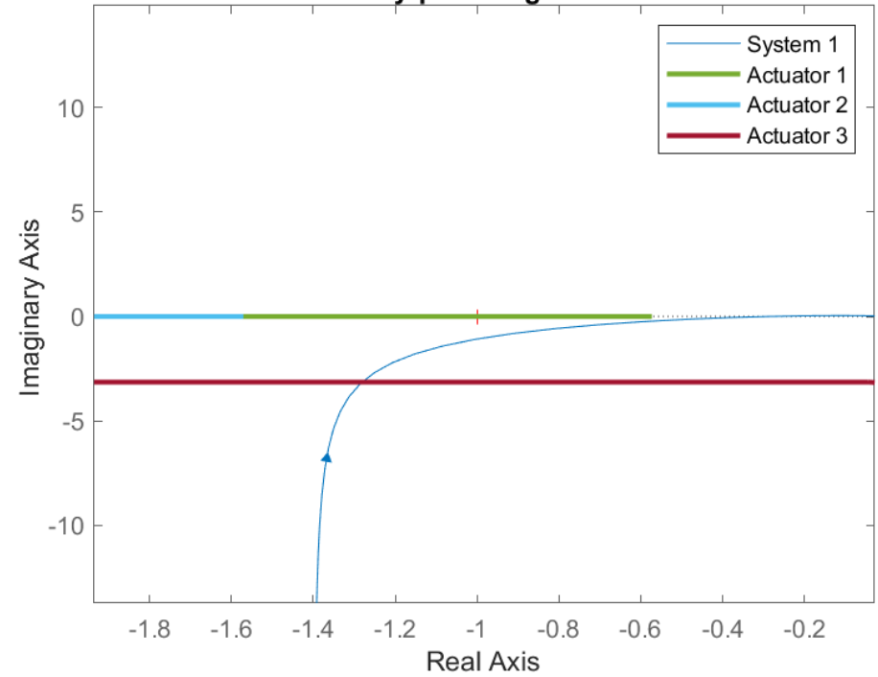
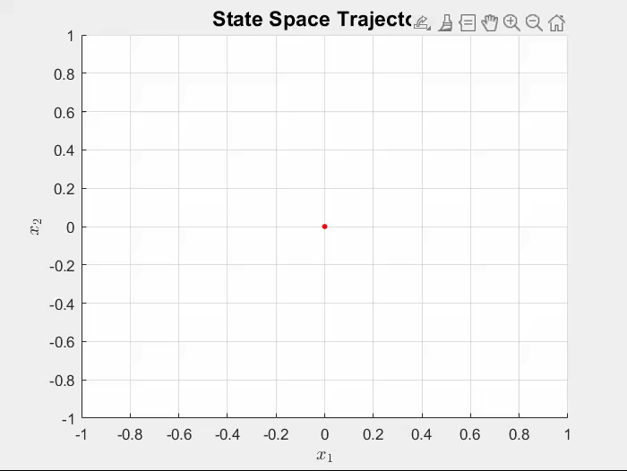
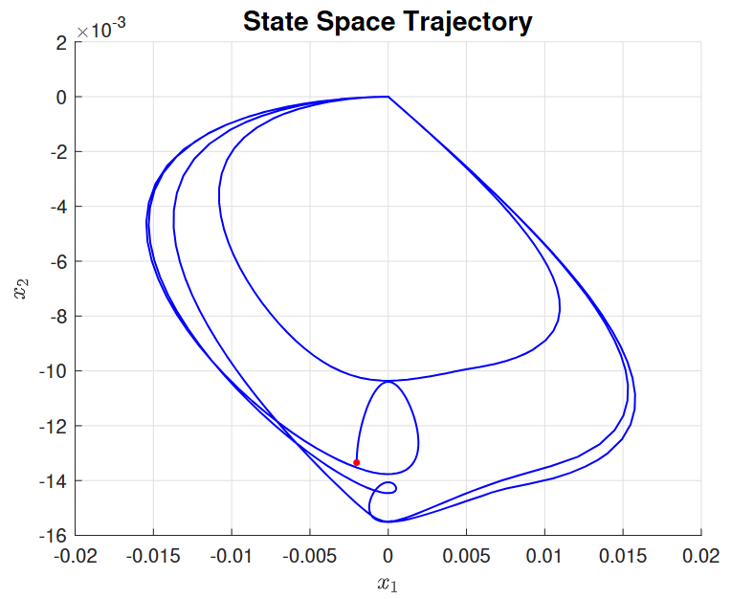
NonLInear actuators
Popov Criteria
ISFL
IOFL
Sliding Mode
System
Limit Cycle Analyses
Limit Cycle Stable
Nyquist Diagram
Amplitude – 2.16
Frequency – 0.56 rad/s
Limit Cycle Simulation

Slide 5
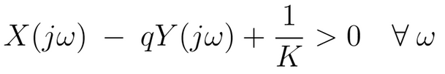
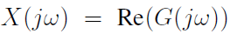
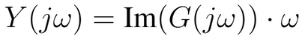
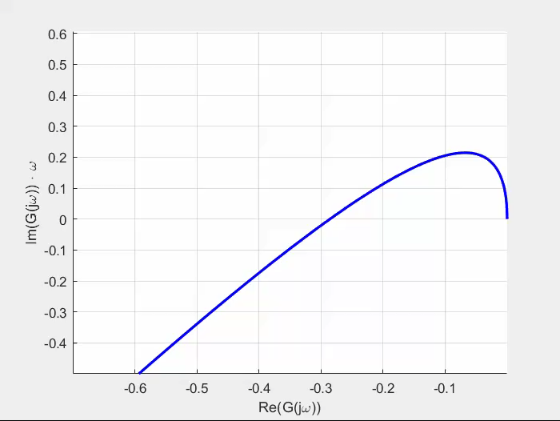
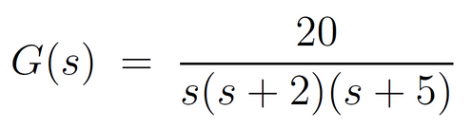
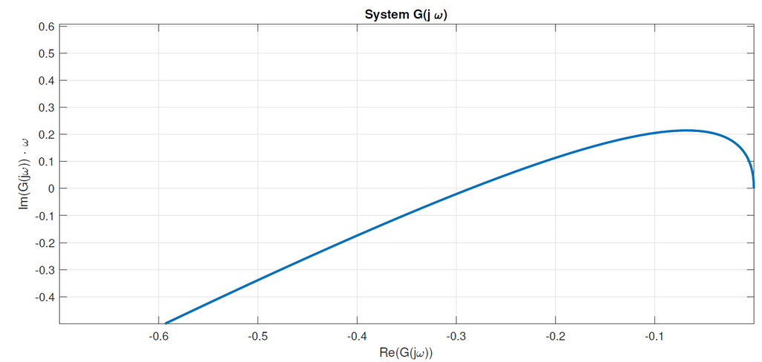
NonLInear actuators
Popov Criteria
ISFL
IOFL
Sliding Mode
Popov Criteria
Popov Inequality
Finding the biggest K
System:
Popov Line
1/q
1/K

Slide 6
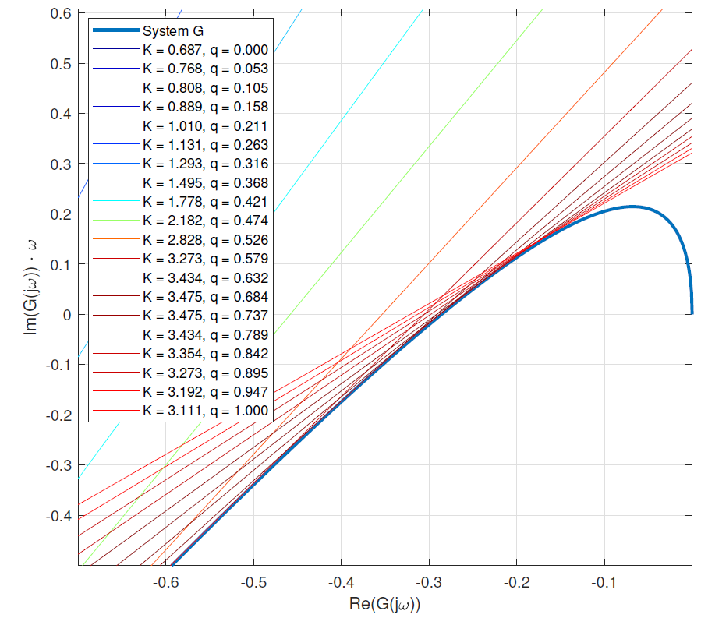
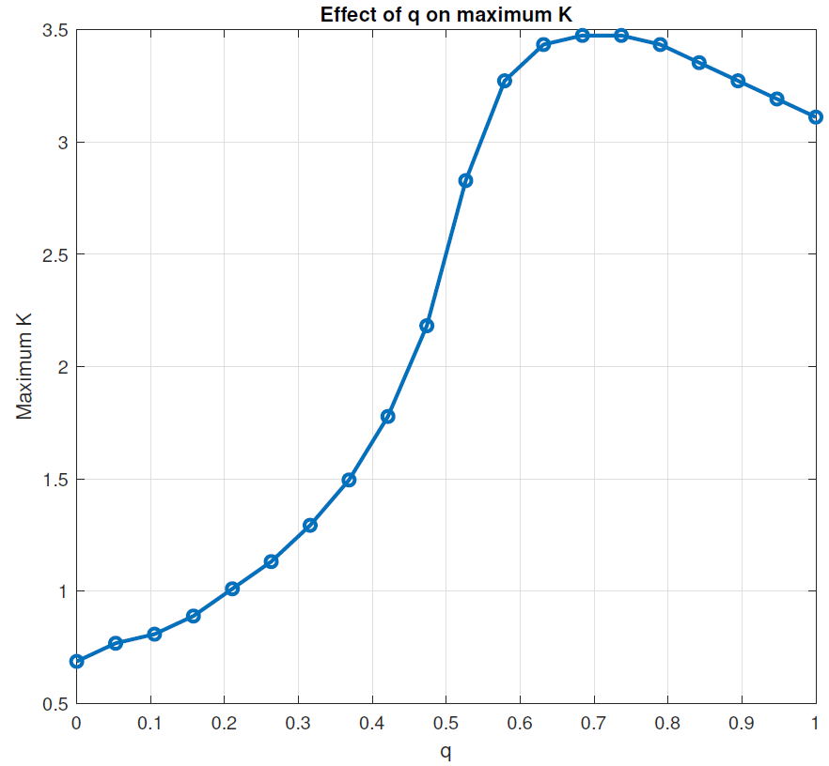
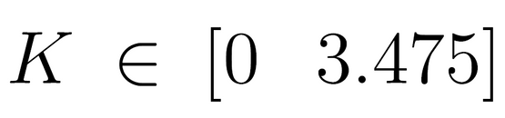
NonLInear actuators
Popov Criteria
ISFL
IOFL
Sliding Mode
Popov Criteria

Slide 7
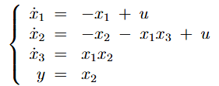
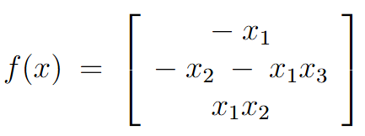
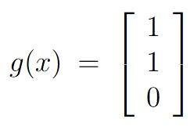
NonLInear actuators
Popov Criteria
ISFL
IOFL
Sliding Mode
Input-State FL
System:
Conditions ISFL
I)
Controllability
II)
Involutivity

Slide 8

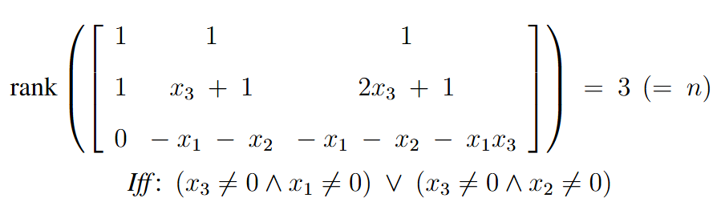
NonLInear actuators
Popov Criteria
ISFL
IOFL
Sliding Mode
Input-State FL
I)
Controllability
System:
Conditions ISFL
II)
Involutivity

Slide 9
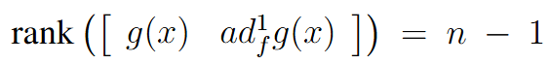
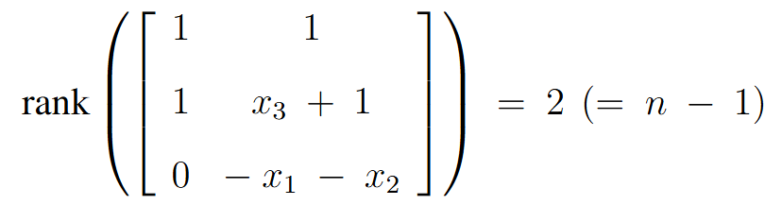
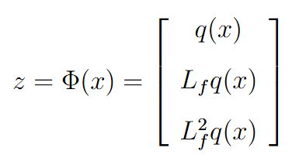
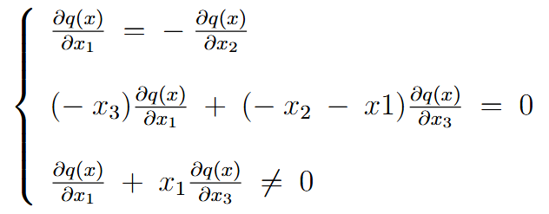
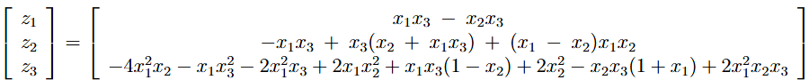
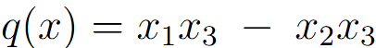

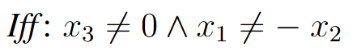
NonLInear actuators
Popov Criteria
ISFL
IOFL
Sliding Mode
Input-State FL
I)
Controllability
System:
II)
Involutivity
Results
Not Invertible

Slide 10
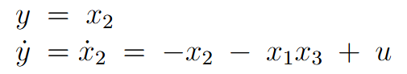

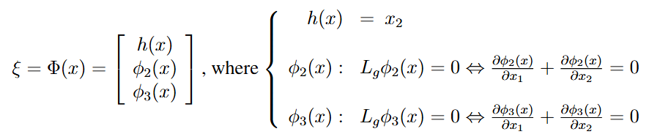
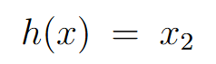
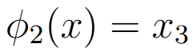
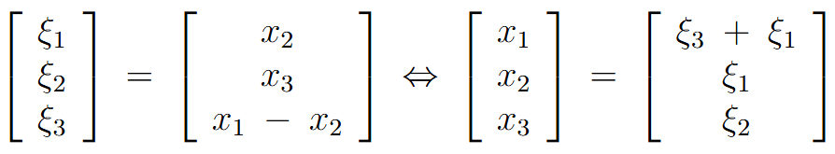
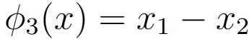
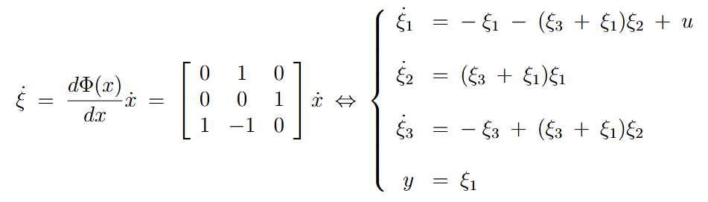
NonLInear actuators
Popov Criteria
ISFL
IOFL
Sliding Mode
Input-Output FL
System:
Invertible
Conditions IOFL
I)
Calculate Relative Degree
II)
State Space Transform
III)
Byrnes-Isidori form

Slide 11
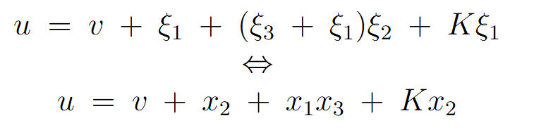
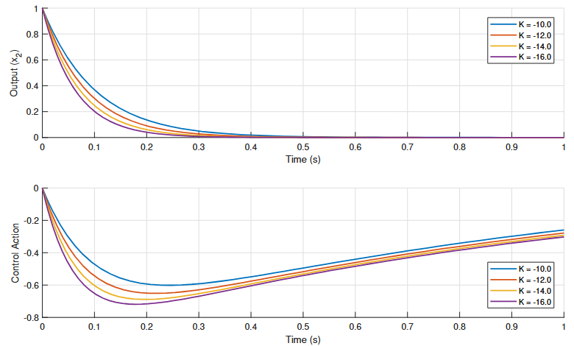
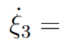
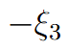
NonLInear actuators
Popov Criteria
ISFL
IOFL
Sliding Mode
Internal Dynamics
System simulation
Feedback Law
Stable

Slide 12
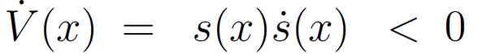
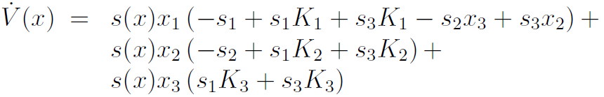
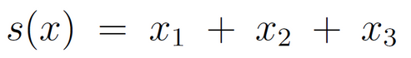
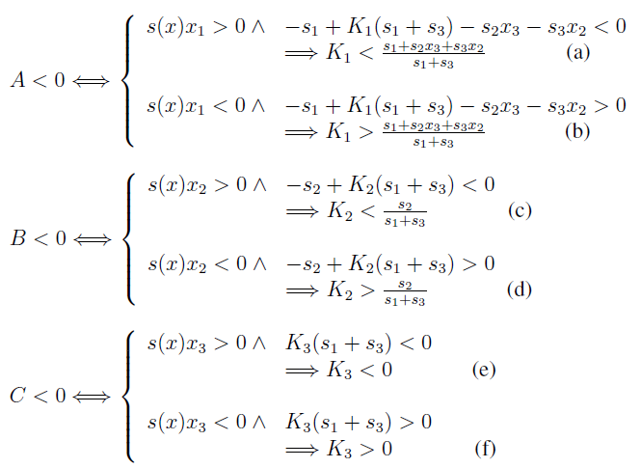
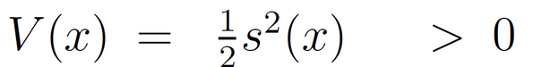
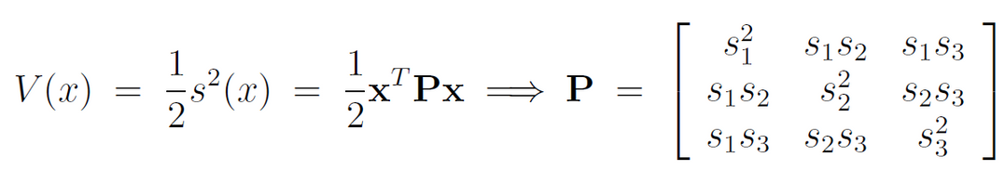
NonLInear actuators
Popov Criteria
ISFL
IOFL
Sliding Mode
Sliding Mode Control
II)
Feedback Law :
01
Sliding surface equation
02
Guarantee that the states are attracted to s(x)
I)

Slide 13
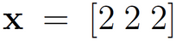
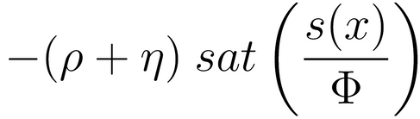






NonLInear actuators
Popov Criteria
ISFL
IOFL
Sliding Mode
Example
Initial states
III)
Finite time convergence
Calculate the gains
Parametric uncertainty = 0.1
03
Guarantee that the states remain on s(x)
Feedback Law

Slide 14



NonLInear actuators
Popov Criteria
ISFL
IOFL
Sliding Mode
PARAMETRIC ANALYSIS

Slide 15

THANK YOU Students Pedro Magalhães
Francisco Carvalho Discipline
NonLinear Control Professor
Miguel Ayala Botto

